Slide 1
P6 Parent
Information Meeting
Tuesday 26th of September

Slide 2
Areas of Learning
Language and Literacy
Mathematics and Numeracy
The Arts
The World Around Us
P.D.M.U.
Grow in Love
P.E.
Notes:
I will start with an outline of the key learning areas.
Language and Literacy includes; Talking and Listening, Reading and Writing
Development of mathematical concepts in number, shape and space, measures and data handling.
I will Talk in more detail about Literacy and Numeracy later
The Arts- Including Art and Design, Drama and Music
WAU- includes; Geography, History and Science, we cover this through our topic work
And
PDMU- develops values such a self-confidence, tolerance and respect as well as opportunities to find out more about themselves as individuals , their support networks and things that influence them. Children find about health issues such as the dangers of smoking.
They develop listening skills and empathy as a means of getting on better with others and as a communication skill.

Slide 3
Language and Literacy
Reading – guided, shared and Accelerated Reading
Writing – poetry, instructions, newspaper articles, letters, stories, reports.
Handwriting – neat presentation.
Grammar and punctuation
Spelling patterns and rules.
Talking and Listening – putting themselves in other’s shoes and ensuring comprehension.

Slide 4
Reading
Guided
Mixture of 'Bug Club' reading books and novels.
Accelerated Reading
Home reading is essential.
Targets and individual book level are shared with children.
15 minutes a day.
Complete AR reading quiz in school. – Email updates.
Shared
Topic/internet/class novel – Charlotte’s Web

Slide 5
Developing Comprehension
Provide opportunities to talk about the story. Recall detail of what has happened. Retell what happened at the beginning/middle/end.
Consider how a character feels.
Look in the text to find clues for questions.
Authorial technique.
How do you know?
Can you show me where you found the answer?
Find a sentence that supports your thoughts.
If you met one of the characters from the story, what would you say to him/her?
Ask questions like….

Slide 6
Phonics – Stage 5 and 6
Same sound can be represented in different ways
See, we, eat
Same spelling can be represent different sounds
We, get
Word ending – station, special , treasure
Investigation – Encourage your child to identify the target sound.
Help your child identify tricky parts to remember
ea | e | y | ee
eat teach stream | we me be | happy mummy lovely | street green feet

Slide 7
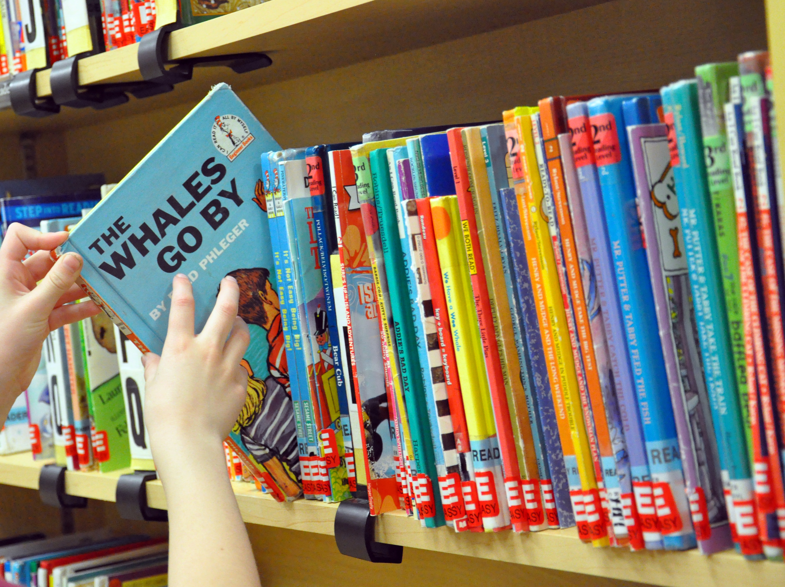
HELPING AT HOME
Everyday Literacy
Maps, Menus, Instructions, Advertising, Fun Jokes, Notes, Fiction / Non-fiction variety, I spy, Newspapers
Make time for reading aloud
Model good reading
Encourage children to use reading strategies
Practise writing spellings down

Slide 8
Mathematics and Numeracy
Number
Place Value to 100000
Addition and Subtraction to 100000
Multiplication
Division
Fractions
Money
Multiplication tables
Processes in Mathematics
Mathematical language
Reasoning
Use and apply
Shape and Space
2D Shapes
3D Shapes
Co-ordinates
Angles and lines
Handling Data
Record data
Interpret data
Measures
Weight
Length
Capacity
Time
Area

Slide 9
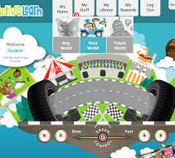
Numeracy Strategies
‘No-work’ place-value additions and subtractions, e.g. 4216 + 322 and 5732 – 701
Counting on to add, e.g. 385 + 43 .
Counting up to subtract (Frog), e.g. 125 – 87.
Counting back to take away, e.g. 174 – 25.
Partitioning to add, e.g. 36 + 85.
Partitioning to take away, e.g. 89 – 45.
Using number facts (bonds, doubles, near-multiples of 10 and adjust) to add and subtract, e.g. 174 + 6, 286 – 8, 154 + 39.

Slide 10
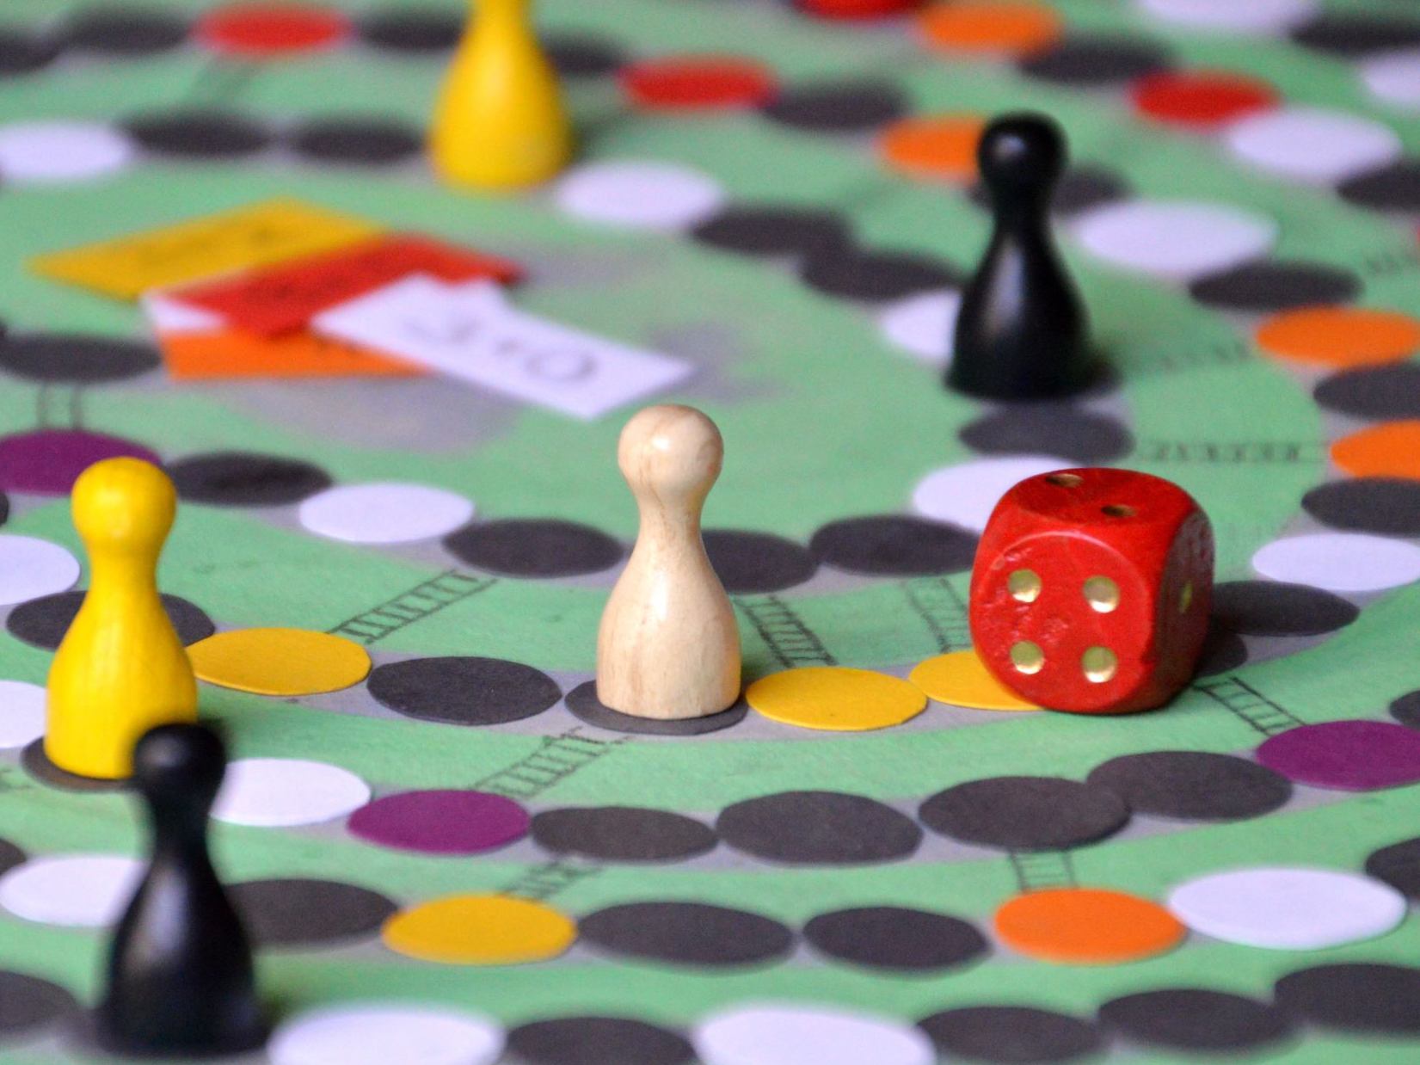
HELPING AT HOME
Practise counting and tables.
Time tables songs to help develop quick recall!
Maths Frame – Interactive maths games
Mathletics
Youtube songs – Numberocks, Mr. DeMaio
Praise and encouragement.
Treat errors as opportunities.
Discuss mathematical language.
Everyday activities e.g shop, cooking, sorting.

Slide 11
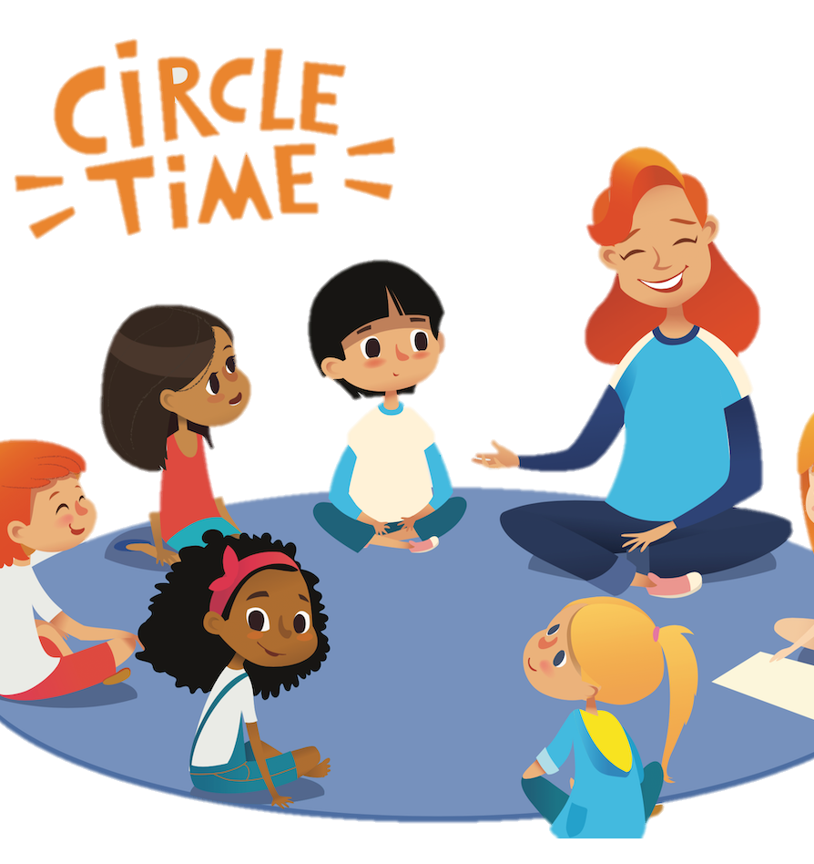
Personal Development and Mutual Understanding
Personal Understanding and Health
Who am I?
Dealing with feelings
Healthy Habits
Mutual Understanding in the Local and Wider Community
Working at harmony
Speaking up for me
Check it out first
Decision! Decision!

Slide 12
What does resilience look like in P6?
Having another go when you make a mistake or experience failure
Saying sorry even if you did something by accident
Seeing a situation from someone else’s point of view
Being happy for others when they do well
Accepting constructive criticism

Slide 13
Homework
Literacy and Numeracy on alternate nights
Phonics, Practice in English and Mental Maths each night
Reading - AR and Guided Reading books
Mathletics - Thursday
Homework guidance on Seesaw
Purpose of Homework
To review, consolidate and practise what the pupils have been doing in school
To share this with parents
To prepare for the next day
To develop research skills
Notes:
Mon- Comp- Comprehension work may involve reading then presenting information in a different format, eg bullet points, a poem or a table instead of the normal list of questions.
Sometimes it includes Dictionary work to build comprehension a vocabulary
Tue- Mental Maths- use a star to indicate that your child found this difficult, we can focus on these next day.
Wed Grammar
Thur- Maths related to what is being done in school
We are all busy, each week seems busier than the last, making time to share a book with your is always time well spent, it is crucial that p6 children read, read and read some more.
P6 children although they can read independently will gain so much more enjoyment and understanding if they can discuss what they read with you, talking about the overall plot and that meanings of words
Homework diaries -sign each week in school and at home
Use it to send a message but make sure that you emphasize that they must show it to me, the diary is in sections and I may only look at one particular section the next day and may not see it.

Slide 14
General Homework Tips
Learn phonics nightly
Times tables practice.
Show you think homework is important.
Set a time for homework.
Monitor their work.
Provide guidance and encourage independence.
Talk with the teacher if problems come up.

Slide 15
Behaviour
Positive reinforcement
Golden rules
Golden Time
Pupil of the week
Class reward system
Class targets
Think Time Discussion Sheets
Restorative questioning
See positive behaviour policy – School website

Slide 16
Meeting the needs of all learners in school
Children have different skills, abilities and interests, they make progress at different rates and have different ways in which they learn best. Praise your child for trying their best and don’t compare them with others, this will build their confidence.
If your child is provided with different work or activities in class from that of their classmates, you should not be worried. All children are different and teachers are highly skilled at using a wide range of approaches and strategies to help children learn.
Teachers look carefully at how they organise lessons, the classroom, the materials and activities they give to each child and the way they teach. This is often called differentiating the curriculum.

Slide 17
What our school does to support individual differences between learners Lots of children will have learning difficulties from time to time and the school is well organised to address this by:-
Grouping the children for learning new tasks
Using different learning materials and resources
ICT
Over learning in the classroom
Small group withdrawal
Use of practical resources
Providing some small “target groups” for literacy and numeracy
Providing training for teachers
All children have their own targets and goals to reach.

Slide 18
The role of parents
Parental involvement in supporting your child in school is vitally important.
Creating positive partnerships with school staff will help your child to feel safe and achieve his or her full potential.
It is important to remember that we are all working together to get the best for the children.
Sharing key information about your child with the school is essential in order that their needs can be met effectively.
Clear communication and a consistent approach between home and school will help support children through transition.

Slide 19
Please Note
P.E. – Tuesday and Thursday
Swimming - Wednesday
HW diary and reading books should come to school every day
Healthy break policy
Nut free zone
Attendance - Illness and absent – report on school website
Partnership with parents
Homework diary
Seesaw
School website – policies
AR – email notifications
Arrange an appointment
Notes:
Anti Bullying policy

